Slide 1

Topics Covered: Fundamentals, Working with Data, Input and output, and Built-In Functions
Semester: 3rd Paper code: AIML203 Subject: Foundations of Data Science

Slide 2
Prerequisite of topic :
Student should have the knowledge of Basic concepts related to Python programming and Python Libraries:Pandas ,Numpy
Objective :To make students aware about the Fundamentals of python,
Working with Data, Input and output and inbuilt functions of python.
Outcome :
Students will be able to understand the basics of Python Programming
Students will be able to implement in Python Libraries and inbuilt functions. .

Slide 3
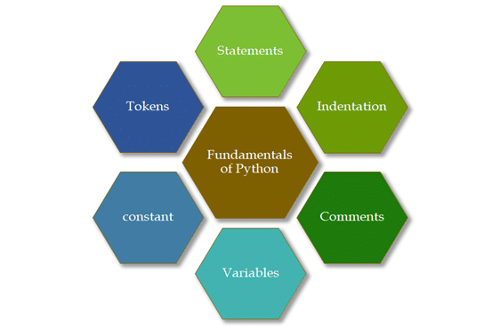
Fundamentals of Python
Indentation
Statements
Variables
Comments
Constant
Tokens

Slide 4
Data Types
Number-Int,Float
Strings:-Concatenating strings using (+)
[List]:-
(Mutable)
How multiple data types can be stored in a Python list.
Indexing and slicing to access a specific element or sub-list of the list.
Helper methods for sorting, reversing, deleting elements, copying, and appending.
Nested lists — lists containing lists. For example, .
Addition in a list.

Slide 5
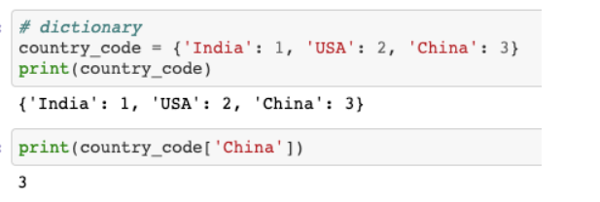
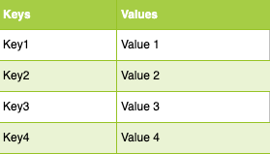
Data Types
(Tuples):-Indexing and slicing (similar to lists) and Nested tuples. It is immutable.
Dictionary:-These are another type of collection in Python. While lists are integer indexed, dictionaries are more like addresses. Dictionaries have key-value pairs, and keys are analogous to indexes in lists.
Example:-
Example:-

Slide 6
Working With Data
Numpy
Pandas
Pandas is a Python library used for working with data sets.
Why Use Pandas?
Pandas allows us to analyze big data and make conclusions based on statistical theories.
What is Data Frames?
A Pandas Data Frame is a 2 dimensional data structure, like a 2 dimensional array, or a table with rows and columns.
NumPy is a Python library used for working with arrays
Why Use NumPy?
In Python we have lists that serve the purpose of arrays, but they are slow to process.
Why is NumPy Faster Than Lists?
NumPy arrays are stored at one continuous place in memory unlike lists, so processes can access and manipulate them very efficiently.

Slide 7
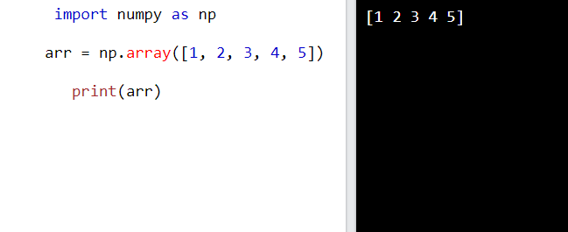
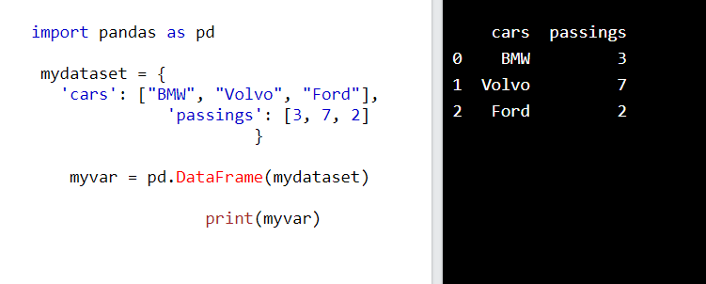
Working With Data
Numpy Example
Pandas Example

Slide 8
Input and Output in Python
How to Take Input from User in Python?
Sometimes a developer might want to take user input at some point in the program. To do this Python provides an input() function.
Where prompt is an optional string that is displayed on the string at the time of taking input.
Syntax:
input('prompt')

Slide 9
Input and Output in Python
Input
Example 1: Python get user input with a message
How to Display Output in Python?
Python provides the print() function to display output to the standard output devices
Syntax: print(value(s), sep= ‘ ‘, end = ‘\n’,)
# Taking input from the user
name = input("Enter your name: ")
# Output
print("Hello, " + name)
print(type(name))
Output:
Enter your name: GFG
Hello, GFG

Slide 10
Input and Output in Python
Input
Example 2: Integer input in Python
Output
Example: Python Print Output
# Python program to demonstrate
# print() method
print("GFG")
# code for disabling the softspace feature
print('G', 'F', 'G')
# Taking input from the user as integer
num = int(input("Enter a number: "))
add = num + 1
# Output
print(add)
Output:
Enter a number: 25
26
Output
GFG
G F G

Slide 11

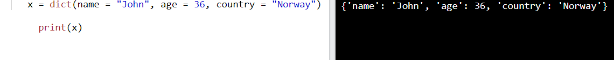
Built-In Functions
Abs() Function:
Dict()

Slide 12
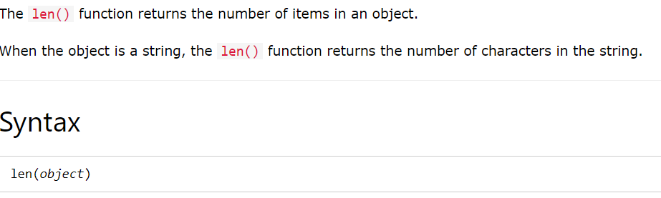
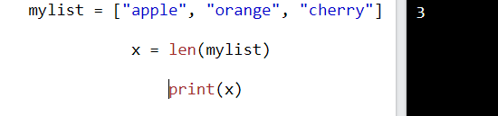
Built-In Functions
Input() Function:- Len() Function:-
Example:-
print("Enter your name:")
x = input()
print("Hello, " + x)
Output:-
Enter your name:Ram Hello, Ram

Slide 13
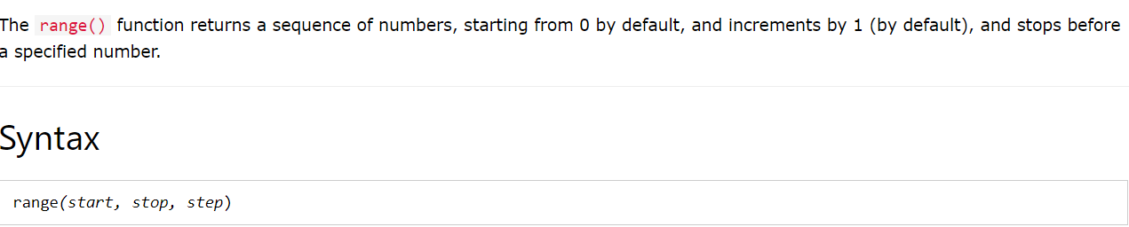
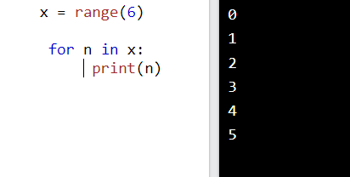
Built-In Functions
Range() Function:-
Example:-

Slide 14
Some technical interview questions:
What are local variables and global variables in Python?
Difference between List and Dictionary?
How to find the length of a string in Python?
Which function is used to take input from user in Python?
Difference Between Token and Identifiers?
Difference Between Range() and XRange()?

Slide 15
Practice Questions:-
https://www.hackerrank.com/challenges/finding-the-percentage/problem?isFullScreen=true
https://www.hackerrank.com/challenges/30-data-types/problem
https://www.hackerrank.com/challenges/input/problem?isFullScreen=true
https://www.hackerrank.com/challenges/python-division/problem?isFullScreen=true
https://www.hackerrank.com/challenges/python-arithmetic-operators/problem?isFullScreen=true
https://leetcode.com/problems/basic-calculator-ii/
https://leetcode.com/problems/two-sum/
https://leetcode.com/problems/reverse-integer/solution/
https://leetcode.com/problems/count-and-say/
https://leetcode.com/problems/combination-sum/
https://leetcode.com/problems/zigzag-conversion/
https://leetcode.com/problems/letter-combinations-of-a-phone-number/
https://leetcode.com/problems/generate-parentheses/
https://leetcode.com/problems/divide-two-integers/
https://leetcode.com/problems/4sum/

Slide 16
References
https://www.w3schools.com/python/pandas/pandas_getting_started.asp
https://www.geeksforgeeks.org/input-and-output-in-python/
https://www.w3schools.com/python/ref_func_range.asp
Video Lectures
https://www.youtube.com/watch?v=qLs_bURpZ04
https://www.youtube.com/watch?v=LHBE6Q9XlzI
Books
Chun W. Core python programming. Prentice Hall Professional; 2001.
Langtangen HP, Langtangen HP. A primer on scientific programming with Python. Berlin/Heidelberg: Springer; 2011 Mar 31.

